Slide 1
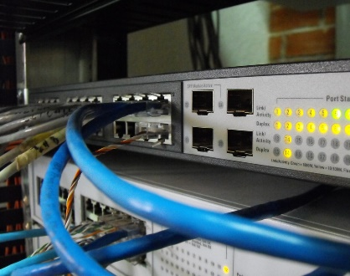
Ethernet: Switching
Mujahid Tabassum
2026
This Photo by Unknown Author is licensed under CC BY-NC

Slide 2
Agenda(1st Part)
Ethernet/MAC Addresses
Switches
Forwarding Table
Frame Forwarding
ARP

Slide 3
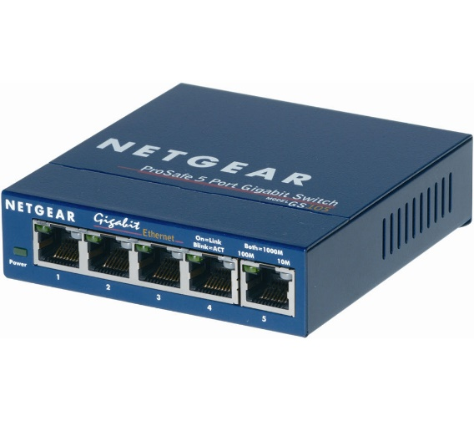
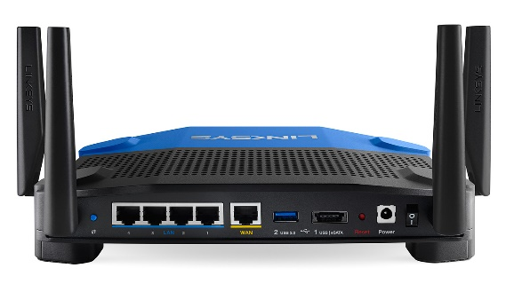
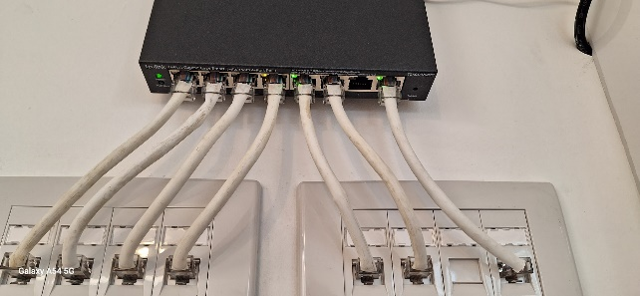
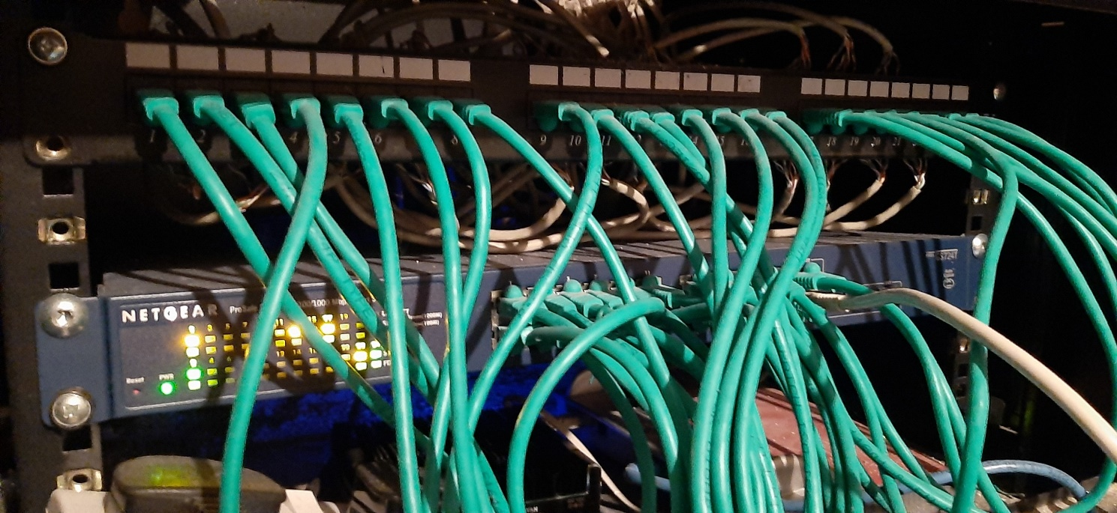
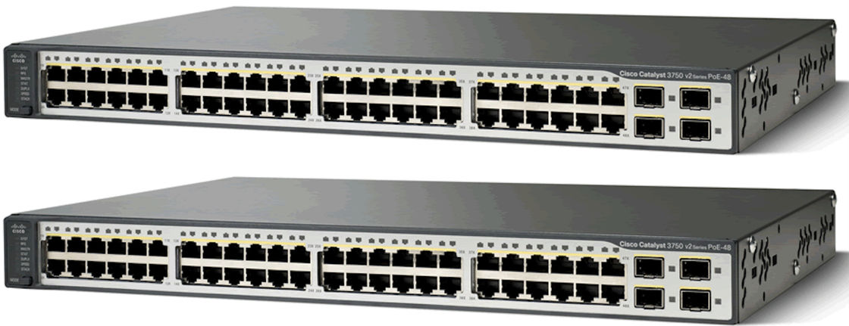
Network Switches are great!
A network switch forwards data packets between devices.
Unmanaged Switches(cheap)
Just plug stuff in and it starts working!
Managed Switches(not so cheap)
Can also be configured for security, Virtual LANS, Traffic prioritisation…
Better switches provide PoE (Power over Ethernet)
Device can use connection for power as well as communication(e.g. Networked Camera)
Notes:
Show Switsh

Slide 4
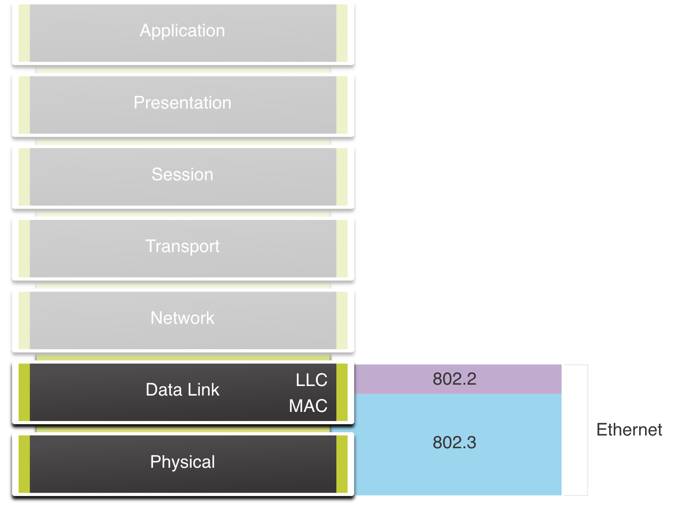
Ethernet Encapsulation
Ethernet operates in the data link layer and the physical layer.
It is a family of networking technologies defined in the IEEE 802.2 and 802.3 standards.

Slide 5
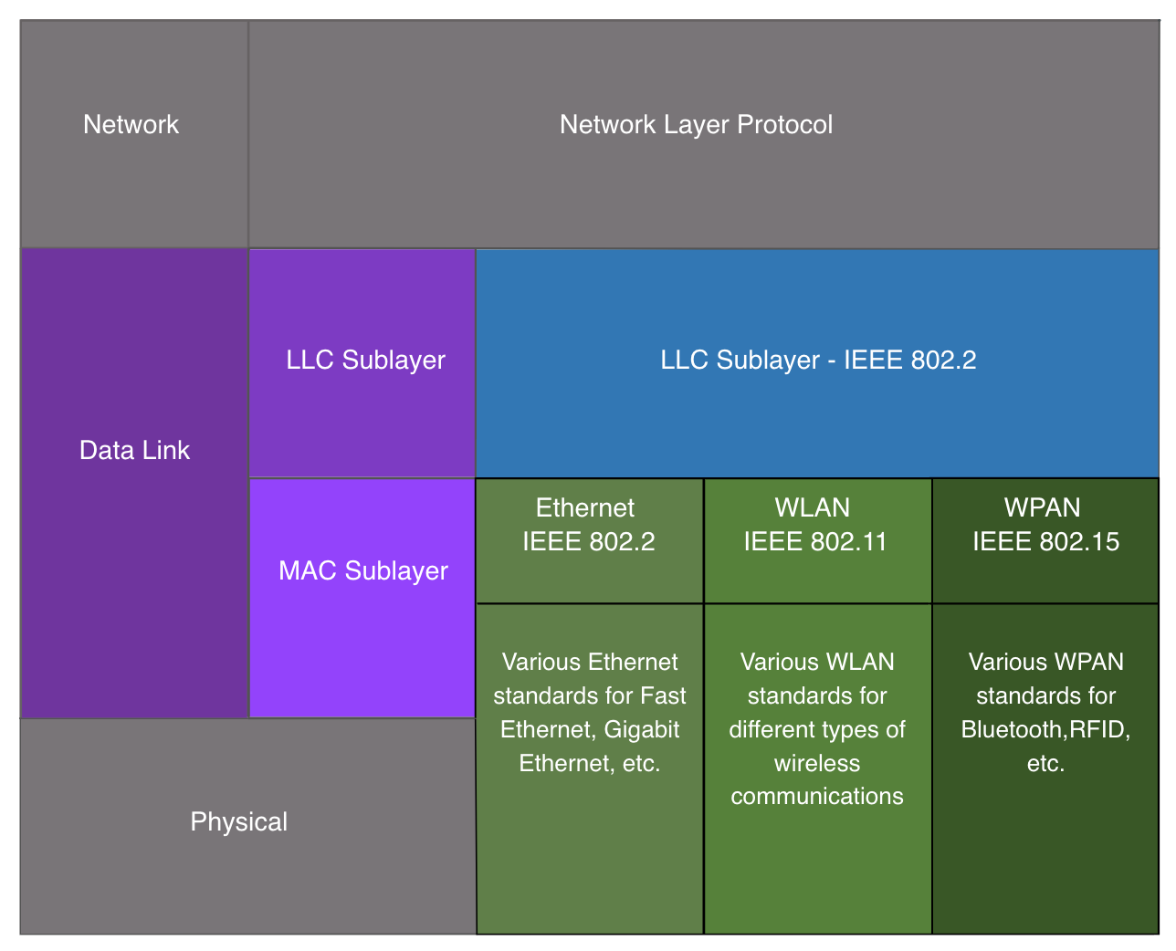
Data Link Sublayers
The 802 LAN/MAN standards, including Ethernet, use two separate sublayers of the data link layer to operate:
LLC Sublayer: (IEEE 802.2) Places information in the frame to identify which network layer protocol is used for the frame.
MAC Sublayer: (IEEE 802.3, 802.11, or 802.15) Responsible for data encapsulation and media access control, and provides data link layer addressing.

Slide 6
MAC Sublayer
The MAC sublayer is responsible for data encapsulation and accessing the media.
Data Encapsulation
IEEE 802.3 data encapsulation includes the following:
Ethernet frame - This is the internal structure of the Ethernet frame.
Ethernet Addressing - The Ethernet frame includes both a source and destination MAC address to deliver the Ethernet frame from Ethernet NIC to Ethernet NIC on the same LAN.
Ethernet Error detection - The Ethernet frame includes a frame check sequence (FCS) trailer used for error detection.

Slide 7
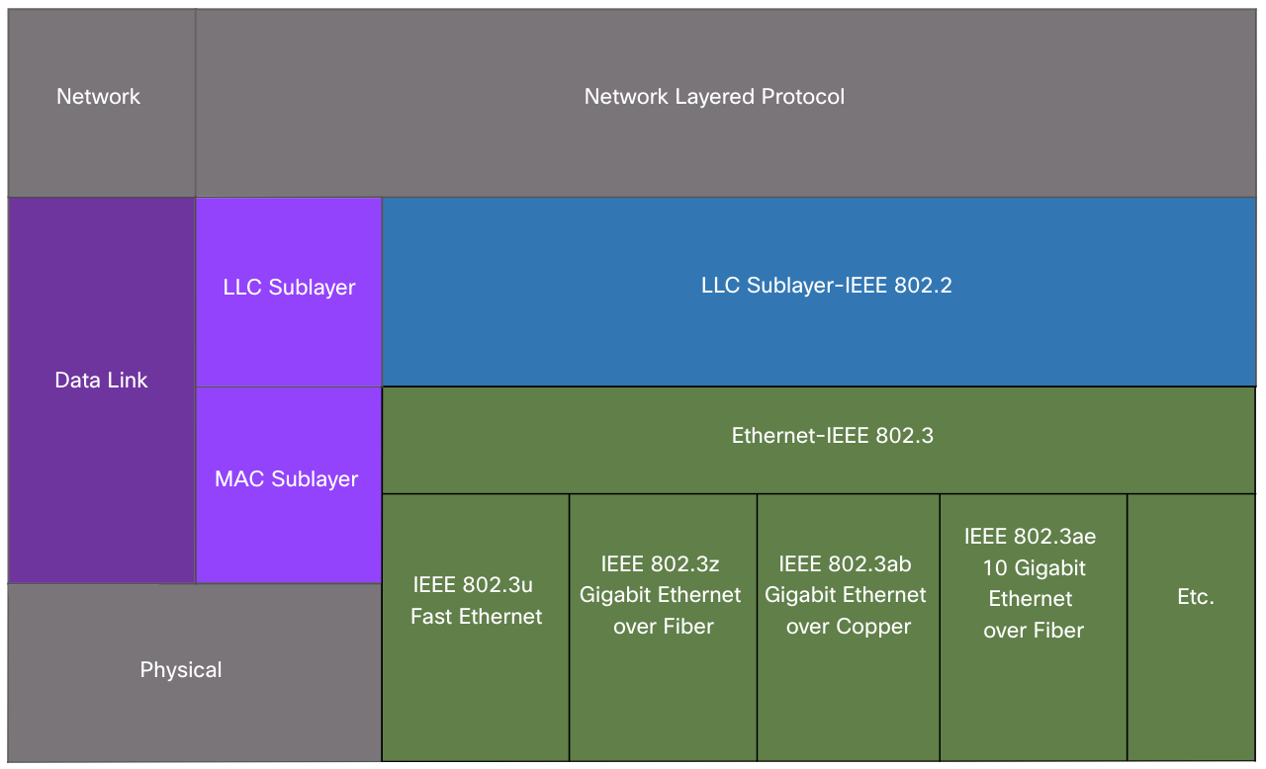
MAC Sublayer
Media Access
The IEEE 802.3 MAC sublayer includes the specifications for different Ethernet communications standards over various types of media including copper and fiber.
Legacy Ethernet using a bus topology or hubs, is a shared, half-duplex medium. Ethernet over a half-duplex medium uses a contention-based access method, carrier sense multiple access/collision detection (CSMA/CD).
Ethernet LANs of today use switches that operate in full-duplex. Full-duplex communications with Ethernet switches do not require access control through CSMA/CD.

Slide 8
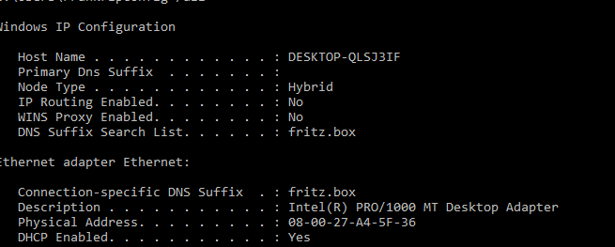
Ethernet Interface: MAC Addresses
Every Ethernet interface must have 6 byte(48 bit) MAC address
Addresses assigned to physical interface by manufacturer/vendor
Example: 80:19:34:95:D1:02
3 octets(24 bits)
3 octets(24 bits)
Organisationally Unique Identifier
Network Interface Controller (NIC) Specific
Usually expressed as HEX

Slide 9
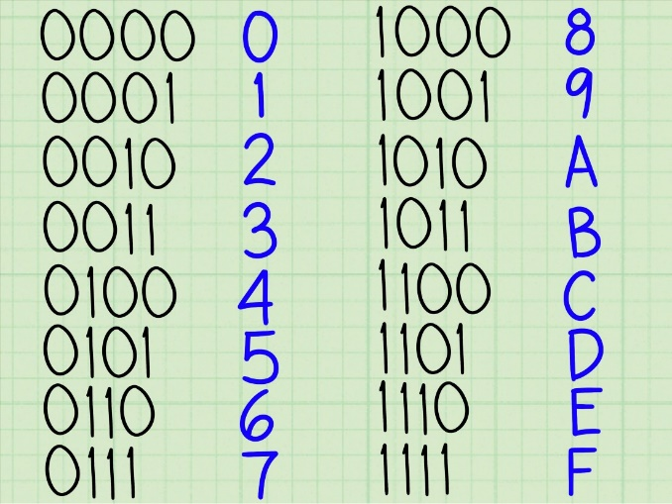
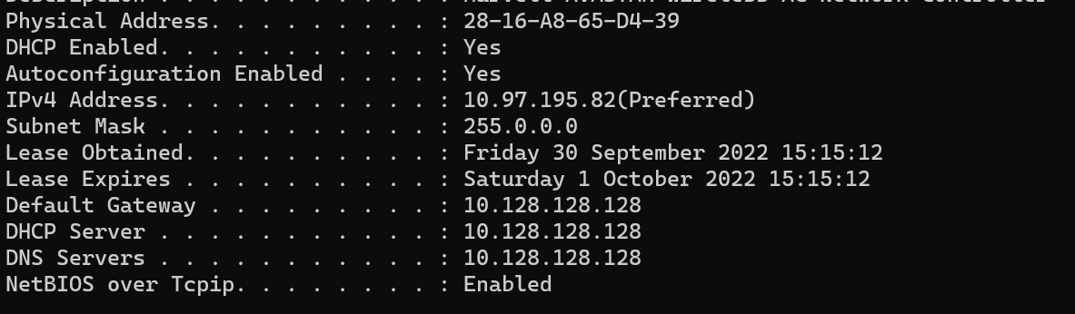

MAC Addresses: Hexadecimal
An Ethernet MAC address consists of a 48-bit binary value, expressed using 12 hexadecimal values.
Each “hex” character represents 4 bits
Given that 8 bits (one byte) is a common binary grouping, binary 00000000 to 11111111 can be represented in hexadecimal as the range 00 to FF,
When using hexadecimal, leading zeroes are always displayed to complete the 8-bit representation. For example the binary value 0000 1011 is represented in hexadecimal as 0b.
Hexadecimal numbers are often represented by the value preceded by 0x (e.g., 0x73) to distinguish between decimal and hexadecimal values in documentation.

Slide 10
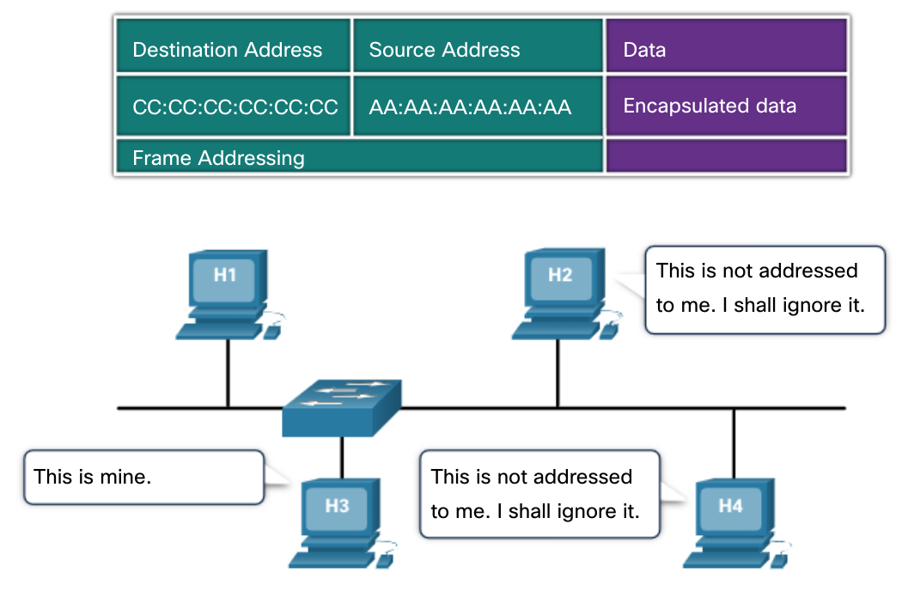
Frame Processing
When a device is forwarding a message to an Ethernet network, the Ethernet header include a Source MAC address and a Destination MAC address.
When a NIC receives an Ethernet frame, it examines the destination MAC address to see if it matches the physical MAC address that is stored in RAM. If there is no match, the device discards the frame. If there is a match, it passes the frame up the OSI layers, where the de-encapsulation process takes place.
Note: Ethernet NICs will also accept frames if the destination MAC address is a broadcast or a multicast group of which the host is a member.
Any device that is the source or destination of an Ethernet frame, will have an Ethernet NIC and therefore, a MAC address. This includes workstations, servers, printers, mobile devices, and routers.

Slide 11
Ethernet: Frame Delivery
Concerned with getting data to correct interface on a device.
Delivery of messages on a single local network
MAC addresses are unique on the local network.
Represents “physical” address
Each network interface inspects destination address of every frame. If it does not match hardware address(or broadcast address), the frame is discarded
Once a frame is successfully received at destination, Layer 2 info is removed as the data is decapsulated and moved up the protocol stack to Network layer(layer 3).

Slide 12
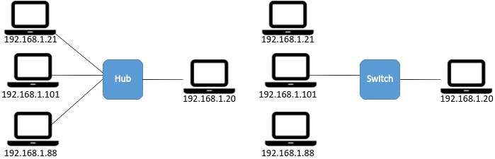

Physical/Link Layer (layer 2) intermediate devices
Hub(Not cool anymore!)
Used to connect devices
Frames sent out on all ports.
Shared Media (only one device can transmit)
Switch
Replaces hubs on Ethernet networks
Ports isolated. Frame is sent just to its proper destination(if known).
Destination MAC does not match mine: IGNORE
Destination MAC matches mine!
Destination MAC matches mine!
Notes:
Hubs are history. Too much traffic. Insecure

Slide 13
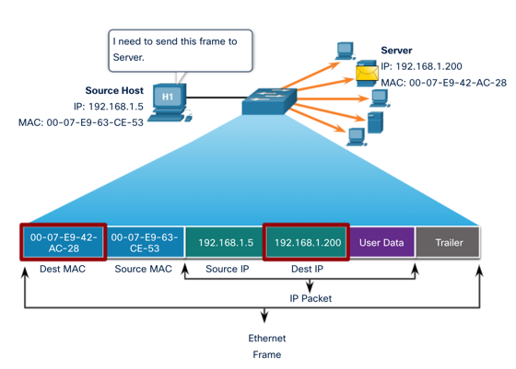
MAC Addresses: Unicast, Destination, Source
Unicast MAC Address:
A unicast MAC address is the unique address that is used when a frame is sent from a single transmitting device to a single destination device.
Destination MAC address is found using Address Resolution Protocol (ARP)
Source MAC Address is always unicast.

Slide 14
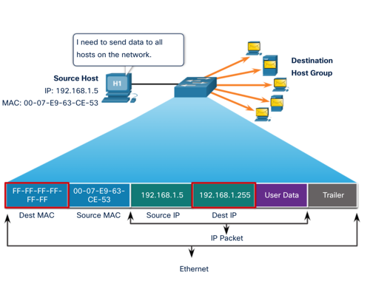
MAC Addressing: Broadcast
An Ethernet broadcast frame has a destination MAC address of FF-FF-FF-FF-FF-FF
received and processed by every device on the Ethernet LAN
Flooded on all Switch ports
If payload is broadcast IP packet, then address portion of IP is all ones(1s)

Slide 15
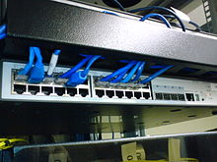
Ethernet: Switching
An Ethernet Switch uses MAC addresses to make forwarding decisions.
It is unaware of the data (or protocol) being carried in the data portion of the frame,
IPv4 packet, an ARP message.
The switch makes its forwarding decisions based solely on the Layer 2 Ethernet MAC addresses.
An Ethernet switch uses a MAC address table to make a forwarding decision for each frame
When a switch is turned on/reset, the MAC address table is empty
This Photo by Unknown Author is licensed under CC BY-SA

Slide 16
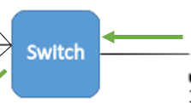

Ethernet: MAC Address Table
So device 00-0A is connected to port fa01.
I better write that down for later use …
A switch builds its forwarding MAC address table by examining the source MAC address of every frame that enters the switch.
If the source MAC address does not exist, it is added to the table along with the incoming port number. If the source MAC address does exist, the switch updates the refresh timer for that entry. By default, most Ethernet switches keep an entry in the table for 5 minutes.
Note: If the source MAC address does exist in the table but on a different port, the switch treats this as a new entry. The entry is replaced using the same MAC address but with the more current port number.
fa01
Address | Port
00-0A | fa01
Note: MAC address in diagram abbreviated to 2 bytes
Notes:
+ How buids address table.. Using source MAC address
+ What if a plug a device into another port

Slide 17
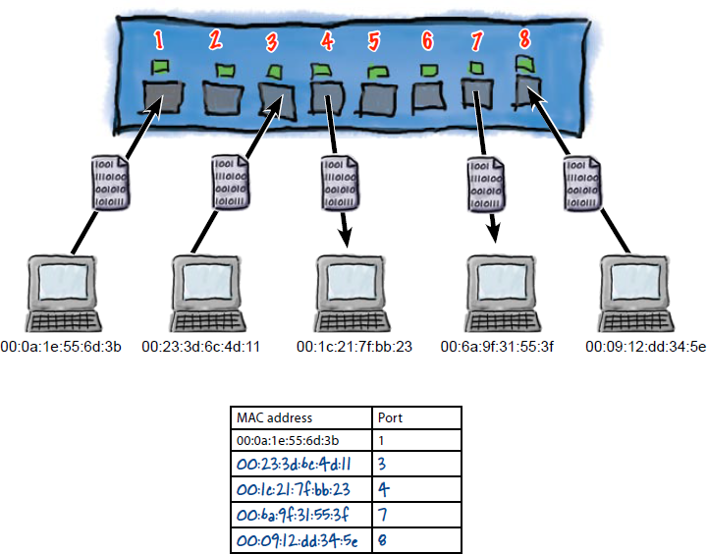
Ethernet: Switch Forwarding Table
A switch will try to match the destination MAC address of the frame and an entry in its MAC address table.
If the destination MAC address is in the table, it will forward the frame out the specified port.
If the destination MAC address is not in the table, the switch will forward the frame out all ports except the incoming port. This is called an unknown unicast.
This Photo by Unknown Author is licensed under CC BY-SA
Notes:
Looks up mac address table using at Destination MAC address + What if it’s not in the table – Send it out on all ports…

Slide 18
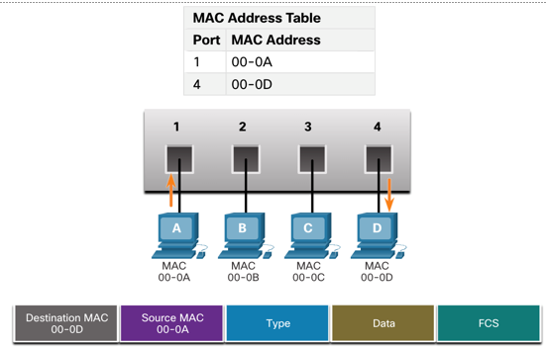
Ethernet: Switch Filtering
When the MAC address table of the switch contains the destination MAC address, it filters the frame and forward out a single port.

Slide 19
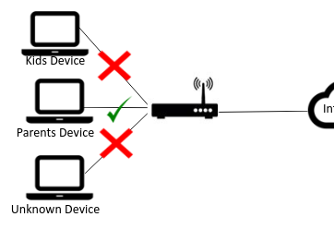
Ethernet: Switch Operation Summary
Learning
MAC table populated by examining traffic across ports
Aging
MAC table entries are timestamped
Removed after a period of time
Flooding
If destination MAC not in address, frame transmitted on all ports on switch
Selective Forwarding/Filtering
Sending frame on one port based on MAC address
Frame Dropping
Performs CRC and drops corrupted frames
Block frames to/from selected MAC addresses

Slide 20
Ethernet: Switch Frame Forwarding

Slide 21
Ethernet: Store-and-forward
Store-and-forward switching
Switch receives the entire frame and computes the CRC. If the CRC is valid, frame is forwarded as usual. If not, frame is dropped
Advantage: High integrity. Determines if a frame has errors before propagating the frame. Discarding frames with errors reduces the amount of bandwidth consumed by corrupt data.
Disadvantage: Overhead of CRC calculation, Added latency of process, increased frame buffering required

Slide 22



Store and Forward
Header
Data
Error Detection
184784387348
MATCH
184784387348
Device calculates CRC value and inserts into frame
Switch stores the frame and calculates/checks the CRC
If no errors (CRC match), frame is forwarded

Slide 23
Ethernet: Cut-Through Switching
Cut-through switching acts on frame data as soon as it is received, even if the transmission is not complete.
The switch buffers just enough of the frame to read the destination MAC address and determine to which port to forward out the data.
The switch does not perform any error checking on the frame.
Fast-forward switching - Offers the lowest level of latency by immediately forwarding a packet after reading the destination address.
Fragment-free switching - A compromise between the high latency and high integrity of store-and-forward switching and the low latency and reduced integrity of fast-forward switching, the switch stores and performs an error check on the first 64 bytes of the frame before forwarding.

Slide 24
Cut Through
sMAC
dMAC
Data
184784387348
Device sends Frame
Switch checks destination MAC as soon as it arrives and begins to forward(NO CRC CHECK)

Slide 25
Ethernet: Memory Buffering
Switches are fast, but may have to deal with large bursts of traffic/congestion, collisions, or a busy destination port
An Ethernet switch buffer is memory that can store frames before forwarding them.
Supports error checking on the received frames.
Prevents the need to drop frames when network congestion occurs.
They provide a mechanism to store a frame for a particular port if autonegotiation of speed or duplex fails.
They hold frames when a collision occurs until normal data transmission resumes.
Port-Based Memory Buffering:
Frames stored in Queues linked to specific ports.
Shared Memory:
Common memory buffer for all frames.
Dynamic links to ports. Enables a Packet to be received on one port and transmitted on another

Slide 26
Port Setting
Two of the most basic settings on a switch are the bandwidth (“speed”) and duplex settings for each individual switch port. It is critical that the duplex and bandwidth settings match between the switch port and the connected devices.
There are two types of duplex settings used for communications on an Ethernet network:
Full-duplex - Both ends of the connection can send and receive simultaneously.
Half-duplex - Only one end of the connection can send at a time.
Autonegotiation is an optional function found on most Ethernet switches and NICs. It enables two devices to automatically negotiate the best speed and duplex capabilities.
Note: Gigabit Ethernet ports only operate in full-duplex.

Slide 27
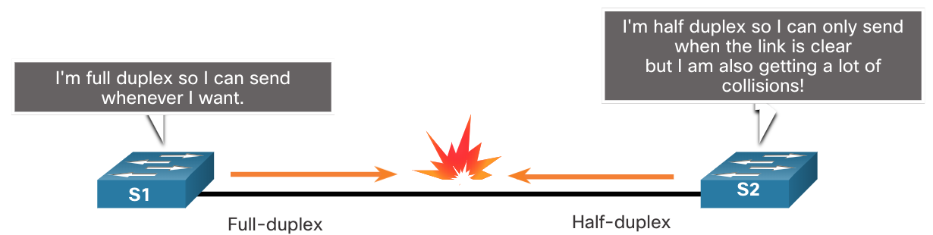
Duplex and Speed Settings
Duplex mismatch is one of the most common causes of performance issues on 10/100 Mbps Ethernet links. It occurs when one port on the link operates at half-duplex while the other port operates at full-duplex.
This can occur when one or both ports on a link are reset, and the autonegotiation process does not result in both link partners having the same configuration.
It also can occur when users reconfigure one side of a link and forget to reconfigure the other. Both sides of a link should have autonegotiation on, or both sides should have it off. Best practice is to configure both Ethernet switch ports as full-duplex.

Slide 28
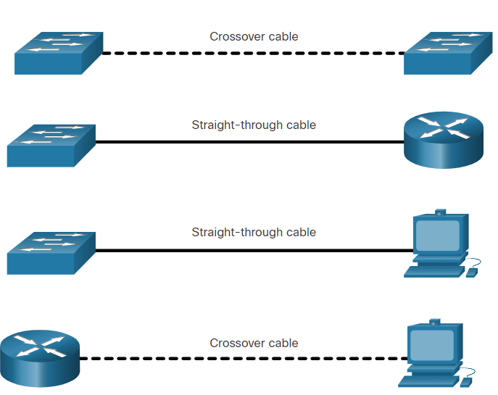
Auto-MDIX
Connections between devices once required the use of either a crossover or straight-through cable. The type of cable required depended on the type of interconnecting devices.
Note: A direct connection between a router and a host requires a cross-over connection.
Most switch devices now support the automatic medium-dependent interface crossover (auto-MDIX) feature. When enabled, the switch automatically detects the type of cable attached to the port and configures the interfaces accordingly.
The auto-MDIX feature is enabled by default on switches running Cisco IOS Release 12.2(18)SE or later. However, the feature could be disabled. For this reason, you should always use the correct cable type and not rely on the auto-MDIX feature.
Auto-MDIX can be re-enabled using the mdix auto interface configuration command.

Slide 29
Key Points
Data Link MAC Addresses - “Physical” address assigned to network interface.
Switched Ethernet now standard practice (no more hubs)
Switch Mac Address Table
Uses MAC addresses to Forward Ethernet Frames to Destination.

Slide 30
ARP
Address resolution protocol

Slide 31


Introduction to ARP
I need to send a message to 192.168.1.88 but I don’t have a MAC address of the device that has that has that IP.
192.168.1.21
192.168.1.101
192.168.1.88

Slide 32
ARP Conversation
Hey everyone! I need to send a message to 192.168.1.88 but I don’t have a MAC address. Is there anybody out there with an IP of 192.168.1.88
ARP request sent to all devices on network: “Broadcast”
192.168.1.21
ARP response sent only to requesting device: “Unicast”
192.168.1.101
Hey, I'm 192.168.1.88 and my MAC address is 00:cd:12:4d:3a:08
192.168.1.88

Slide 33
Address Resolution Protocol
The Address Resolution Protocol (ARP) is used by a sending device when it knows the IP address of the destination but needs the Ethernet address.
ARP is a broadcast protocol - every host on the network receives the request.
Each host checks the request against it’s IP address - the right one responds.
Hosts remember the hardware addresses of each other.

Slide 34
The ARP Process – Mapping IP to MAC Address
Ethernet frames must have a destination MAC address
Devices will maintain a table in memory that maps IP addresses to MAC addresses: the ARP Table
The ARP table is populated using 2 mechanisms:
Monitor traffic on the local network
Broadcast an ARP request
ARP request is broadcast to all devices on the Ethernet network.
Node receiving an ARP request that identifies the IP address as it sends a single response (I.e. unicast) back to the sender. Senter uses this to update the ARP table

Slide 35
ARP Request for device on another network
Sending device needs to send a message to a device on another/external network. What's the destination MAC address???
Sending device will use the MAC address of the "default gateway" - usually the MAC address of the router interface that routes to that network
What if the ARP table doesn't contain an entry for the default gateway???
Device will perform ARP request for MAC

Slide 36
Maintaining ARP tables
Devices remove ARP table entries that have not been used in a specified period.
Period differs across devices. Typically, 2 minutes for Windows.
Example use: Device removed from network/switched off

Slide 37
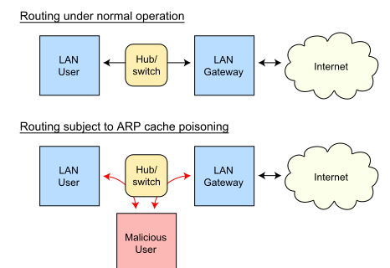

ARP Issues...
Media Overhead
A lot of traffic can be generated by ARP request (broadcast). Minimal impact in typical business setting in well “segmented” network.
Security
ARP Spoofing/Poisoning: Attacker forges MAC address – frames sent to wrong device...
Example: Using your Raspberry pi to monitor traffic from a mobile phone on your network

Slide 38
Key Points -ARP
Ethernet uses ARP to determine MAC addresses
Each device has an IP address and a MAC address.
ARP resolves IP addresses to MAC addresses

Slide 39
Quiz
Which of the following will a Switch use to populate it’s MAC-Address-Table?
Destination IP address
Source MAC address
Destination MAC address
Source IP address

Slide 40
Quiz
What does a switch use to make frame forwarding decisions:
Destination IP address
Source MAC address
Destination MAC address
Source IP address

